Slide 1

Project Title :
AI-Based Customer Churn Prediction and Customer Analytics System
A DBMS and Machine Learning Based Customer Management System
B.Tech Artificial Intelligence & Data Science
DBMS Mini Project
Present By :
Sanket Thakare
Smarth Dalu

Slide 2
PROBLEM STATEMENT
Problem Statement
Customer data is stored in different areas.
Difficult to connect customer, payment, usage, and complaint information.
Manual analysis takes time.
Difficult to identify customers at risk of churn.
Need a structured database and intelligent prediction system.
“Companies have large amounts of customer data, but it can be difficult to manage related information and identify customers who may leave the service.”
MAIN GOAL
Main Goal: Manage customer data efficiently and predict customer churn risk.
03

Slide 3
PROPOSED SOLUTION
Proposed Solution
Our system combines DBMS and AI/ML.
01
02
03
04
Store customer data in MySQL.
Connect related data using Primary Keys and Foreign Keys.
Use SQL queries and database features for analysis.
Collect customer usage, payment, and complaint information.
05
06
07
Use Machine Learning to predict churn probability.
Classify customers into Low Risk, Medium Risk, and High Risk.
Display customer information and prediction results on a web dashboard.
Customer Data → MySQL Database → SQL Analysis → Machine Learning Model → Churn Probability → Risk Level → Dashboard
04

Slide 4




TECHNOLOGY STACK
Technology Stack
Frontend
Backend
Database
Machine Learning
React.js
FastAPI, Python
MySQL
Python, Pandas, Scikit-learn, Joblib
DATABASE FEATURES
DATABASE TABLES
Database Features: Primary Key; Foreign Key; SQL Queries; JOIN; GROUP BY; Aggregate Functions; Views; Stored Procedures; Triggers; Indexes; CRUD Operations.
Database Tables: Customers; Subscriptions; Usage; Payments; Complaints; Churn Labels; Predictions, Activity Logs.
05

Slide 5



Database Feature | Where We Use It | Purpose
Primary Key | customers.customer_id | Uniquely identifies each customer.
Foreign Key | payments.customer_id, usage.customer_id, etc. | Connects different tables and maintains relationships.
SQL Queries | Throughout the database | To insert, retrieve, update, delete, and analyze data.
JOIN | Customer analytics and churn data | Combines data from multiple tables.
GROUP BY | Dashboard analytics | Groups data such as customers by plan or risk level.
Aggregate Functions | Analytics | Calculates COUNT, AVG, SUM, MIN, and MAX.
Views | customer_churn_view | Combines data from multiple tables into a virtual table for analysis and ML.
Stored Procedures | Customer profile and high-risk customer analysis | Stores reusable SQL operations inside the database.
Triggers | activity_logs | Automatically records database changes such as INSERT, UPDATE, or DELETE.
Indexes | Frequently searched/joined columns | Improves database search and query performance.
CRUD Operations | Customer management | Allows Create, Read, Update, and Delete of customer records.
Database Architecture
Companies collect customer details, subscriptions, service usage, payments, and complaints.
Managing information separately makes analysis difficult.
Customer churn means a customer stops using a company’s service.
Our system stores customer data in a structured MySQL database.
Machine learning predicts which customers may be at risk of leaving.
Results are displayed through a web dashboard.
02

Slide 6
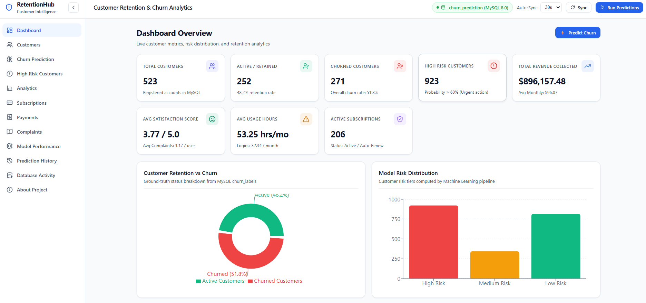
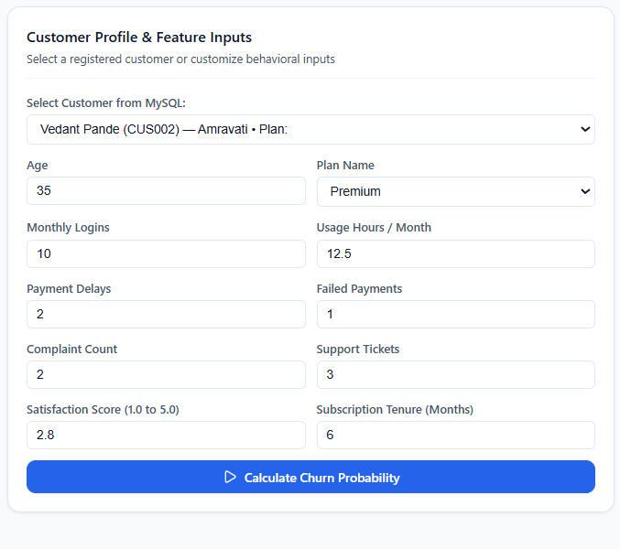
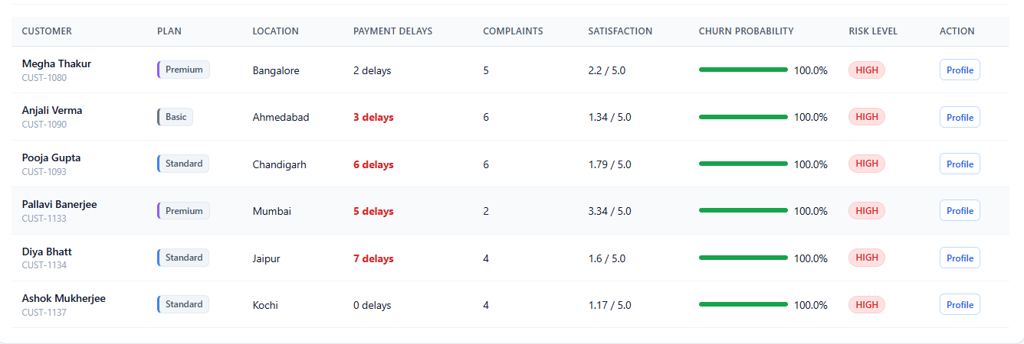
Dashboard

Slide 7
CONCLUSION
Conclusion
The system provides a centralized customer database.
MySQL manages customer-related information efficiently.
SQL and DBMS features help analyze the data.
Machine Learning predicts customer churn risk.
Customers can be classified into Low, Medium, and High risk.
React and FastAPI provide an easy-to-use web interface.
The system combines DBMS and AI to support customer analysis.
Overall, our project helps manage customer data efficiently and identify customers who may be at risk of leaving the service.
FUTURE SCOPE
Future Scope: Real-time customer monitoring; Better ML models; Automated alerts; Customer retention recommendations.
07

